Slide 1
Introduction to Computers for Engineers: Recitation #6

Slide 2
Learning Objectives
Understand the format of a 2D Matrix (aka 2D Array) in MATLAB
Understand how to index rows and columns
Understand how to use nested loops to help you index rows and columns
Continue to develop an understanding of loops

Slide 3
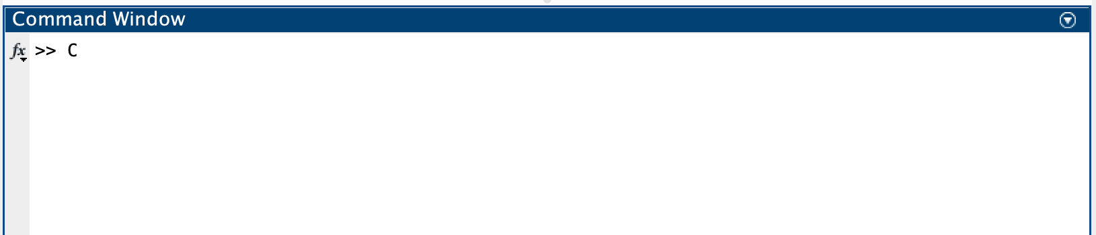
Question 1: Function called “test”
function [my_output] = test(my_input)
[output] = test(input)
(A)
function (my_output) = test[my_input]
[output] = test(input)
(B)
function (my_output) = test[my_input]
test(input)
(C)
function [test] = my_output(my_input)
[output] = test(input)
(D)

Slide 4
Question 2: Looping arrays
for i=1:length(array)
if array > 0
disp(‘hello’)
(A)
for i=1:array
if array(i) > 0
disp(‘hello’)
(B)
for i=1:length(array)
if array(i) > 0
disp(‘hello’)
(C)
for i=1:array
if array > 0
disp(‘hello’)
(D)

Slide 5
Activity 1: Matrices in MATLAB
The objective of this activity is to introduce how to create matrices (2D arrays) in MATLAB
1. Choose a basic geometric shape
Draw it on the whiteboard
2. Think about how you would create that shape with numerical elements in a 6 row x 6 column matrix (2D array)
1’s represent the shape, 0’s represent the background
Draw this matrix on the whiteboard
3. Write code that creates this matrix in MATLAB
4. Once the matrix is stored as a variable, write the command imagesc(variable), where “variable” is the name of your variable to see a visualization of your shape

Slide 6
Loops and Arrays
Loops
myArray = theNumbersBelow;
for i = 1:1:length(myArray);
myArray(i) = myArray(i);
end
i
2
5
6
2
5
9
0
3
2
4
5
6
7
3
4
6
8
9
0
4

Slide 7
Loops and Arrays
myMatrix = theNumbersBelow;
[rows, cols] = size(myMatrix);
for i = 1:1:rows
for j = 1:1:cols
myMatrix(i,j) = myMatrix(i,j);
end
end
i
i
j
i
2
5
6
2
5
9
0
3
2
4
5
6
7
3
4
6
8
9
0
4
5
3
7
2
5
9
1
3
2
4
0
6
4
3
3
6
0
9
7
5
1
1
6
9
9
3
0
4
3
5
5
2
7
5
4
9
8
2
0
4

Slide 8
Activity 2: Nested Loops
Write a function called matrixSum with one input variable my_matrix and output variable matrix_sum
my_matrix: matrix (2D array)
matrix_sum: double
We want this function to take the sum of all of the elements in our input matrix.
Procedure
Write a line of code that determines the number of rows and columns in your matrix
[rows, cols] = size(matrix);
Set up nested loops to count through indices of your matrix (i.e. every combination of row and column indices that exists)
Before your loops create a variable that will store the sum of every number in your matrix
Inside of your loops add value of the element at the current index to the current value of your sum variable
Discuss and write test cases and test your function
Come up with at least 2 different test matrices
Notes:
NewX = X + num
X = NewX

Slide 9
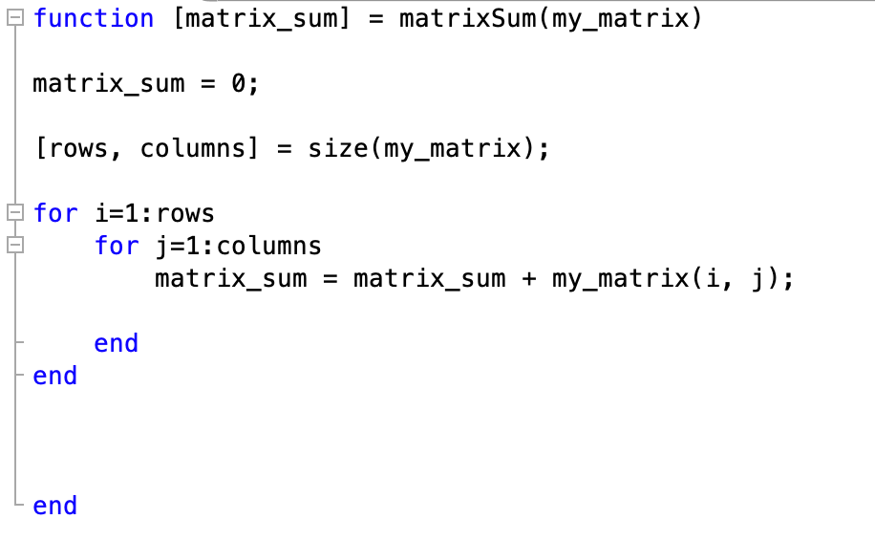
Activity 2: Solution
Notes:
NewX = X + num
X = NewX

Slide 10
Activity 3: Loops and Conditional Statements
The objective of this activity is to get used to putting conditional statements inside of loops
Write a function called primeSum with one input variable my_matrix and output variable prime_sum
my_matrix: matrix (2D array)
prime_sum: double
Instead of taking the sum of every element in your matrix, we only want to take the sum of prime numbers of the matrix
You can use the built-in function isprime to help you
isprime(number) returns false if number is not prime and true if the number is prime
Discuss and test your code with different test cases.

Slide 11
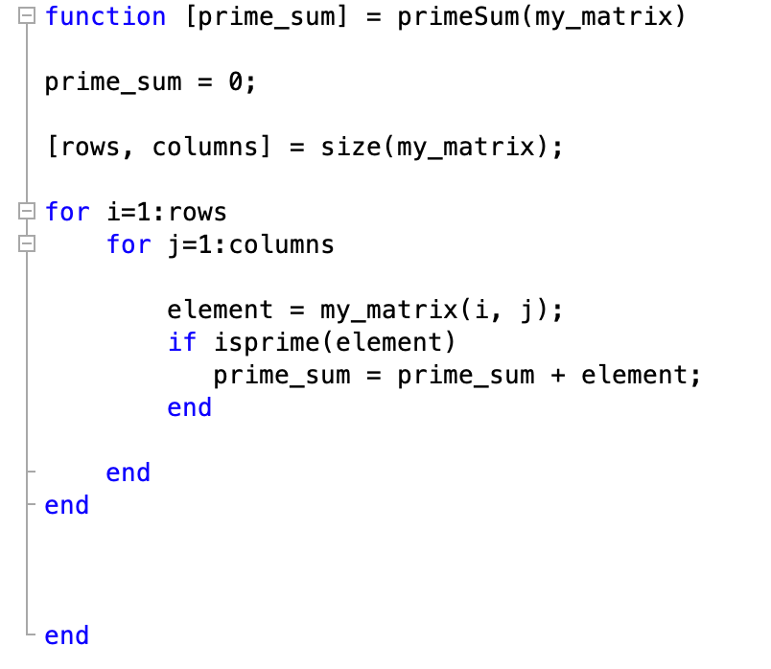
Activity 3: Solution

